Slide 1

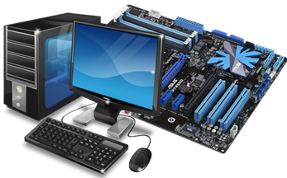
Kurdistan reigonal government
Ministry of higher education
University of Human Development
IT Department
Latest Computer Hardware
Prepared By :
Blnd Arif Payam Khalid Hedi Xalil
Hawrez Aziz Yad Rizgar
2019 – 2020 C

Slide 2
Table of contents
Title Cover .................................................................................................... Page i
Table of content .......................................................................................... Page ii
Introduction ................................................................................................. Page 3
Evolution of Computer Hardware ............................................................... Page 4
Universal Memory ........................................................................................ Page 5
SSD And HDD ………................................................................................... Page 6
DDR4 SDRAM ……….................................................................................... Page 7
CPU ……………………………................................................... ....... page 8,9,10
Computer input Devices ……….......................................................... Page 11 - 19
Computer Output Devices ................................................................. Page 20 - 29
Summary ..................................................................................................... Page 30
References ................................................................................................... Page 31
15/9/2019
Computer Hardware
UHD
Page ii

Slide 3
Introduction
In this Presentation we are goingto talk about all the types of latest Computer hardware including all input and output devices printers and other peripherals.
15/9/2019
Computer Hardware
UHD
Page iii

Slide 4
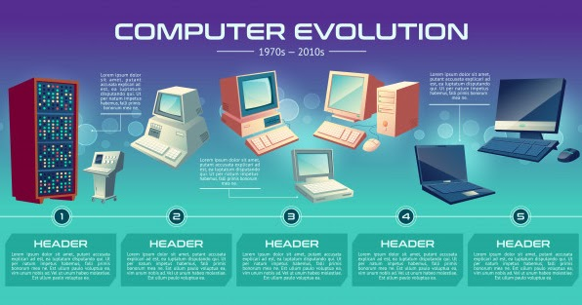
Computer Hardware evolution
1.1 Moore's Law.
15/9/2019
Computer Hardware
UHD
Page 4

Slide 5
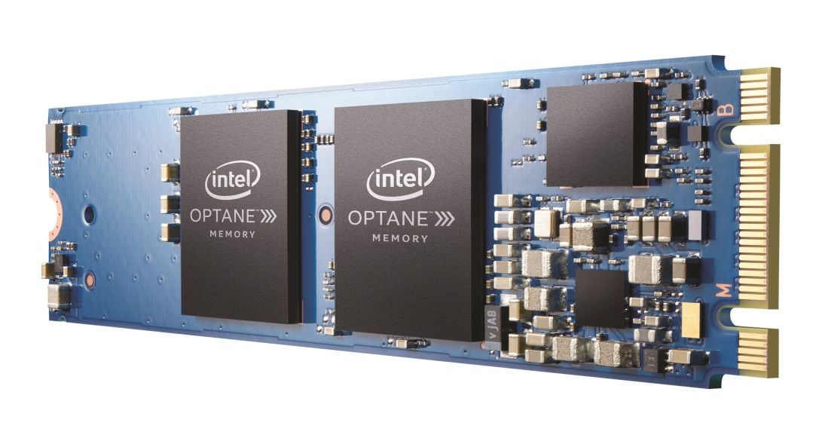
Primary and Secondary Memory
2.1 Universal Memory
SRAM.
Universal Memory.
15/9/2019
Computer Hardware
UHD
Page 5

Slide 6
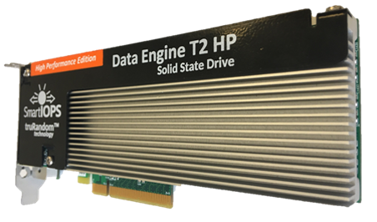
Primary and Secondary Memory
3.1 Hard Disks:
3.1.1 SDD: (FGR) Floating gate transistors, 0 and 1
3.1.2 types of SSD
Data Engine T2HP is in a class of its own, surpassing 1.7 million random IOPS and 6.8GB/s in bandwidth per SSD.
15/9/2019
Computer Hardware
UHD
Page 6

Slide 7
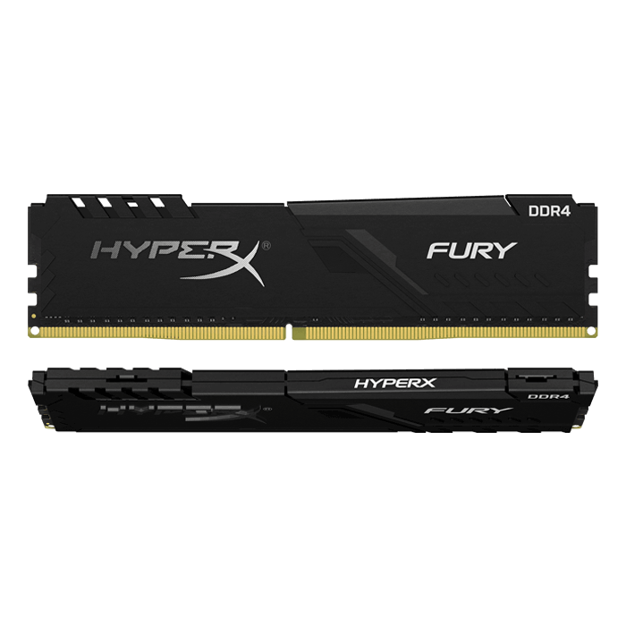
Primary and Secondary Memory
4.1 DDR4 SDRAM & GDDR4 SDRAM :
4.1.1 DDR4 SDRAM (Double Data Rate Synchronous Dynamic RAM)
Fastest DDR4 SDRAM 2133 MT/s (million transfers per second) and 4266 MT/s. 1.2 Volts,
higher standard clock speeds (up to 1600 Mhz). uses a 288-pin configuration,
4.1.2 (GDDR SDRAM)
DDR4 SDRAM
15/9/2019
Computer Hardware
UHD
Page 7

Slide 8
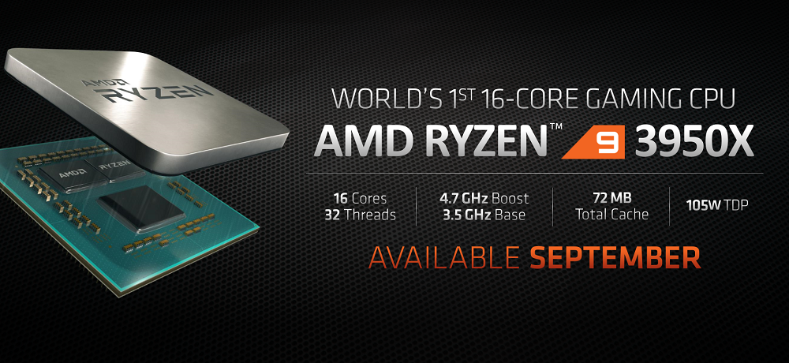
Computer CPU
AMD Ryzen 9 3950x
Cores: 16 | Threads: 32 | Base clock: 3.5GHz | Boost clock: 4.7GHz | L3 cache: 64MB | TDP: 95W US$749
Intel Core i9-9980XE
Cores: 18 | Threads: 36 | Base clock: 3.0GHz | Boost clock: 4.4GHz | L3 cache: 24.75MB | TDP: 165W US$1,989
AMD Ryzen 9 3900X
Cores: 12 | Threads: 24 | Base clock: 3.8GHz | Boost clock: 4.6GHz | L3 cache: 64MB | TDP: 105W US$729.99
15/9/2019
Computer Hardware
UHD
Page 8

Slide 9
Computer CPU
Intel Core i9-9900K
Cores: 8 | Base clock: 3.6GHz | Boost clock: 5.0GHz | L3 cache: 16MB | TDP: 95W
US$494.99
AMD Ryzen 5 2600X
Cores: 6 | Threads: 12 | Base clock: 3.6GHz | Boost clock: 4.32GHz | L3 cache: 16MB
| TDP: 95W US$149
AMD Ryzen 3 2200G
Cores: 4 | Threads: 4 | Base clock: 3.5GHz | Boost clock: 3.7GHz | L3 cache: 4MB
| TDP: 65W US$79.99
AMD Ryzen 5 3600X
Cores: 6 | Threads: 12 | Base clock: 3.8GHz | Boost clock: 4.4GHz | L3 cache: 32MB
| TDP: 95W US$239
15/9/2019
Computer Hardware
UHD
Page 9

Slide 10
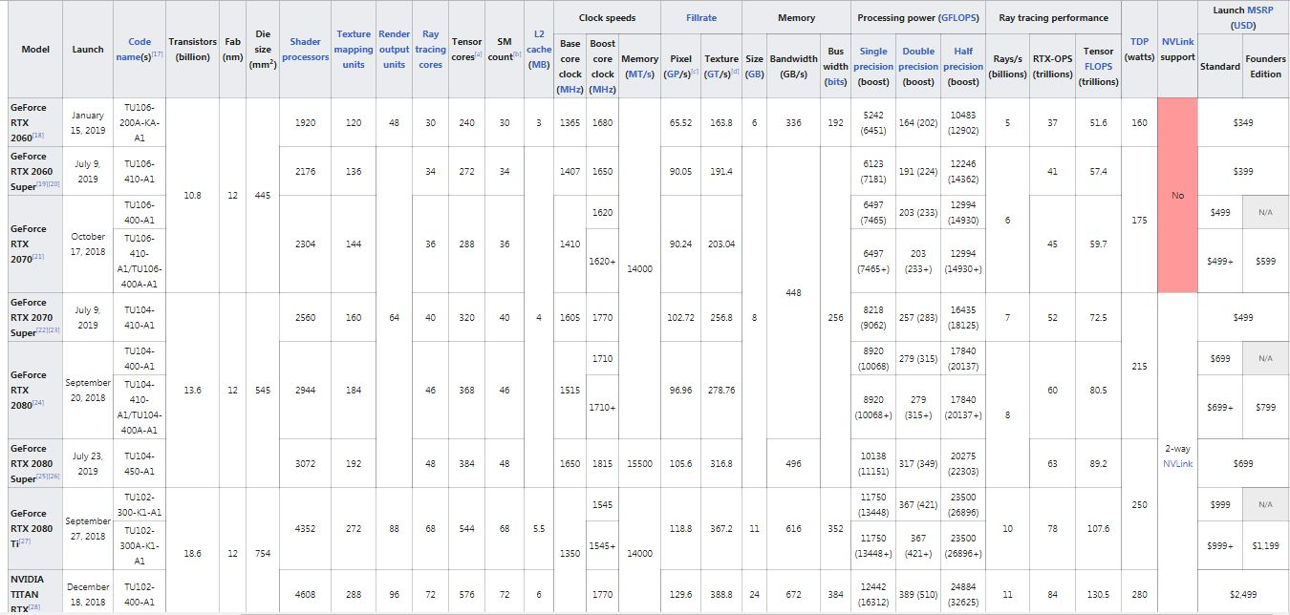
Computer GPU
15/9/2019
Computer Hardware
UHD
Page 10

Slide 11
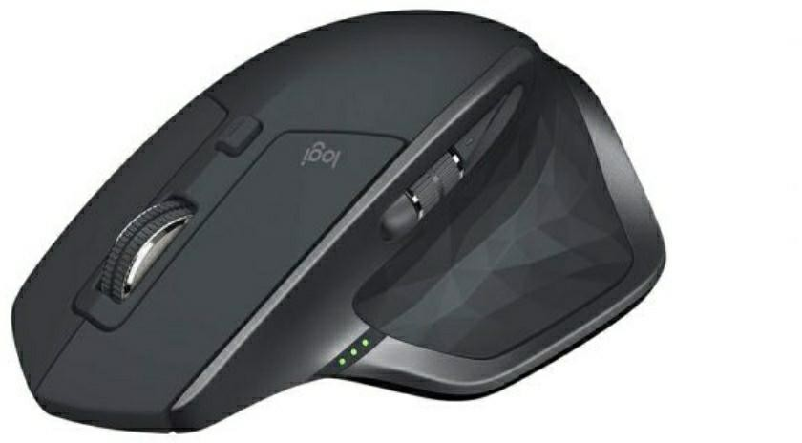
Computer Input Devices
Logitech MX Master 2S
The best mouse for creatives right now
DPI: 4,000 | Interface: Bluetooth and 2.4GHz wireless | Buttons: 7
| Ergonomic: Right-handed | Features: Scrolling wheel, Customizable buttons, Thumb wheel, ergonomic build
+Customizable buttons
+Unbelievable tracking
-Not ambidextrous
15/9/2019
Computer Hardware
UHD
Page 11

Slide 12
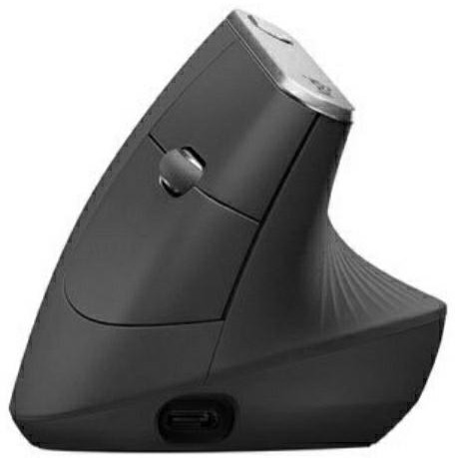
Computer Input Devices
Logitech MX Vertical
An extremely comfortable vertical mouse
DPI: 4,000 | Interface: Bluetooth (up to three devices); USB-C | Buttons: 6
| Ergonomic: Right-handed | Features: Ergonomic build, Easy-Switch and Flow- Enabled, Fast recharging, Cursor speed switch
+Ergonomic design
+ Fast recharging
+4-month battery life
-Pricey
-Slightly odd design
15/9/2019
Computer Hardware
UHD
Page 12

Slide 13

Computer Input Devices
Logitech M185 wireless mouse
A reliable, popular and low-cost option
DPI: 1000 | Interface: 2.4 GHz wireless connectivity; USB receiver | Buttons: 3
| Ergonomic: Ambidextrous | Features: Scroll wheel
+Great value
+12 months battery life
+Plug-and-play
-Basic option
15/9/2019
Computer Hardware
UHD
Page 13

Slide 14
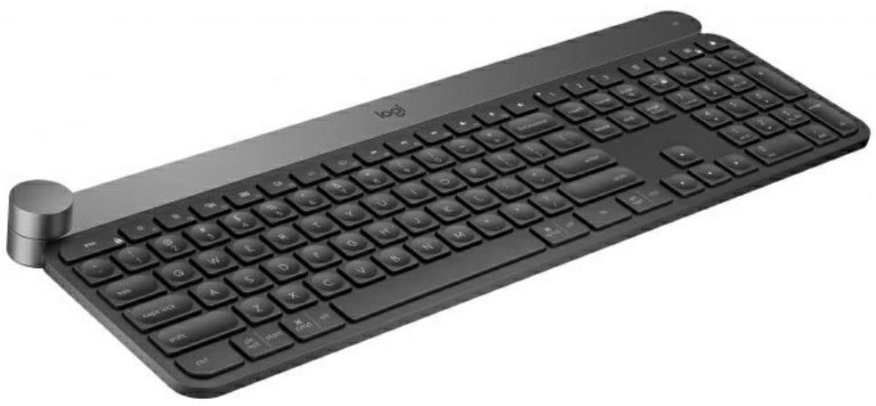
Computer Input Devices
Logitech Craft
The best overall keyboard for designers
Size: 43x14.9x3.2cm | Weight: 960g | Range: Wireless to 10m
| Power: Rechargeable (USB-C)
US$149.99
+ Multi-function Creative Input Dial
+ Backlit with ‘hand-detection’
- Very expensive
- Dial favours right-handers
15/9/2019
Computer Hardware
UHD
Page 14

Slide 15
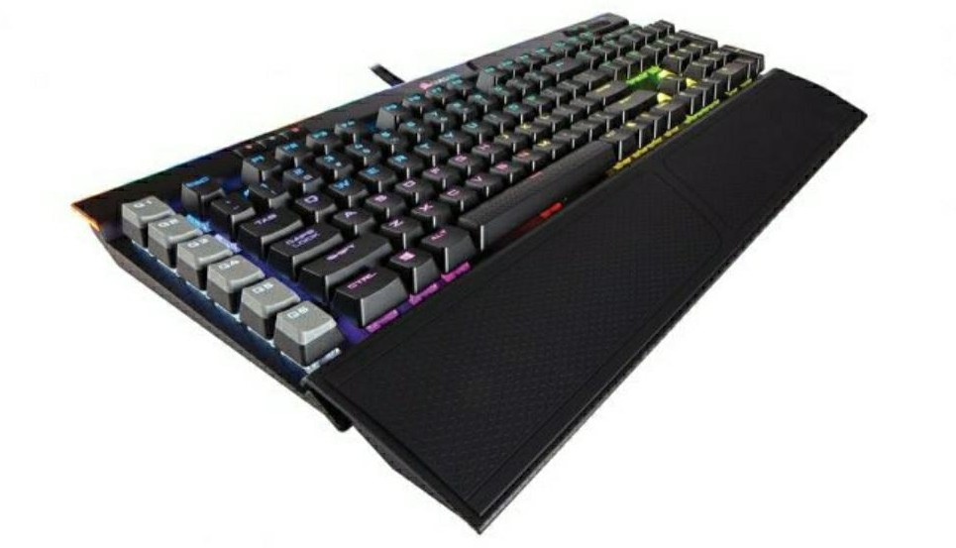
Computer Input Devices
Corsair K95 RGB Platinum
This RGB mechanical keyboard isn't just for gamers
Size: 46.5x17.1x3.6cm | Weight: 1324g | Range: Wired (2m USB cable)
| Switches: Cherry MX switches
US$159.99
+ Quality aluminium frame
+ Onboard memory to save macros
-Palm rest gets grubby quickly
-Complex software
15/9/2019
Computer Hardware
UHD
Page 15

Slide 16
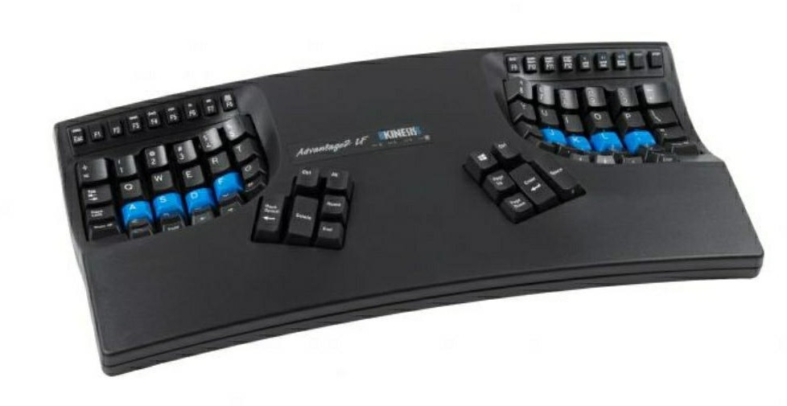
Computer Input Devices
Kinesis Advantage2 LF
The best ergonomic keyboard to reduce the risk of RSI
Size: 41.9x20.3x7.3cm | Weight: 998g | Switches: Cherry MX switches
€370.23
+ Ergonomic design minimises strain
+ Up to 48 programmable macros
-Extremely expensive
-Thick and bulky (but small footprint)
15/9/2019
Computer Hardware
UHD
Page 16

Slide 17
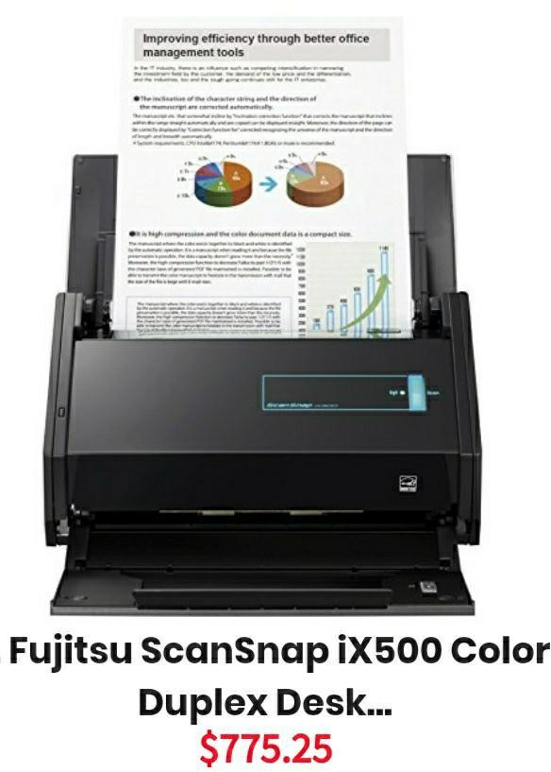
Computer Input Devices
Fujitsu ScanSnap ix500 Scanner
PROS:
1. Very fast at scanning to searchable PDF.
2. Met its rated simplex and duplex scan speeds.
3. Good optical-character-recognition (OCR).
4. Did well at reading business cards.
5. Misfeed-free in our testing.
6. Wi-Fi and USB 3.0 connectivity.
CONS:
1. You can’t give a scan command from within an application.
2. Scanning to some programs may require several steps.
3. Only connects wirelessly to one computer at a time.
4. Documentation could use improvement
15/9/2019
Computer Hardware
UHD
Page 17

Slide 18
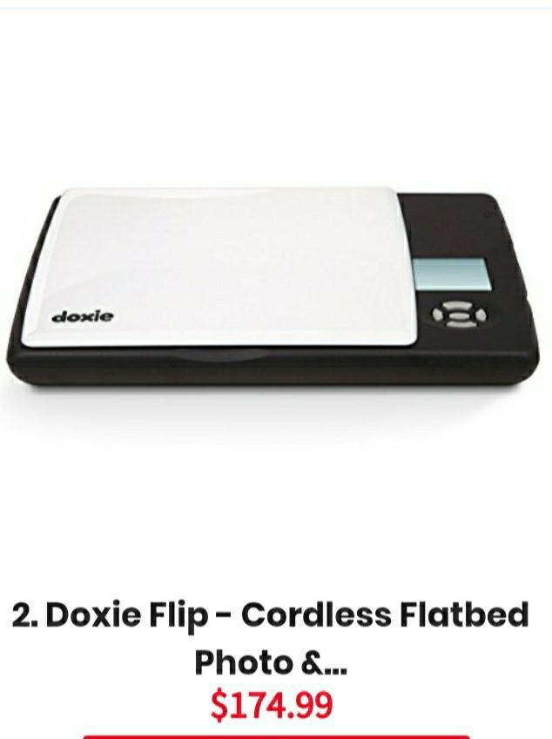
Computer Input Devices
Doxie Flip Mobile Flatbed Scanner
PROS:
Compact and lightweight design.
Completely cordless.
Easy to use, no setup required.
Can scan almost any surface.
The Doxie app has some helpful features like Stitch or Staple.
Brilliant image quality.
CONS:
Colors of scans are not accurate.
Still too big to carry around.
15/9/2019
Computer Hardware
UHD
Page 18

Slide 19
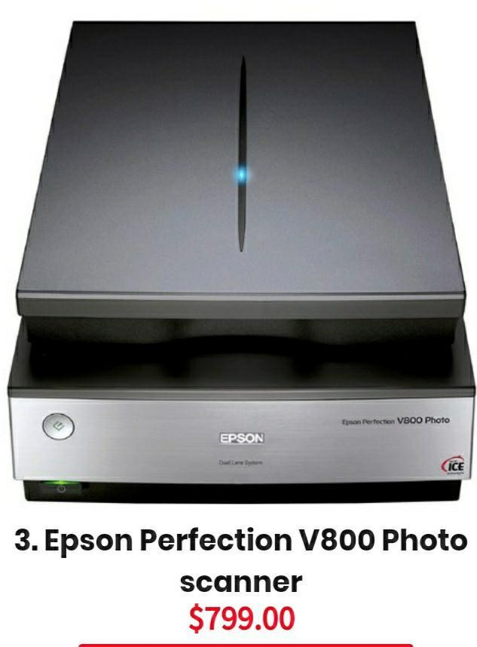
Computer Input Devices
Epson Perfection V800 Photo Scanner
PROS:
High-quality scans for photographic prints and film (including slides).
Scan modes range from full auto to full control over settings.
CONS:
Doesn’t come with a photo editor or any other application program.
15/9/2019
Computer Hardware
UHD
Page 19

Slide 20
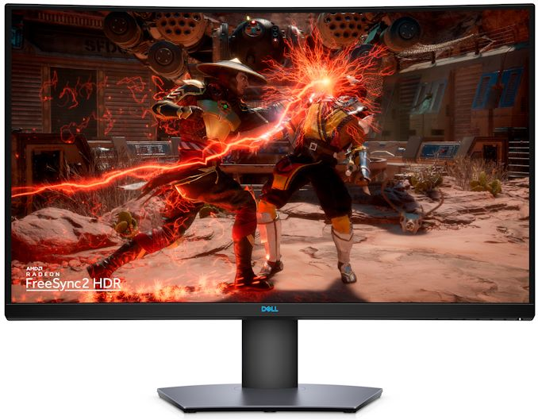
Computer Output Devices
Latest monitor model:
dell s3220dgf
34 inch
165 Hz
2560*1440 resolution
Display 1.07 billion of colors
$599.99
15/9/2019
Computer Hardware
UHD
Page 20

Slide 21
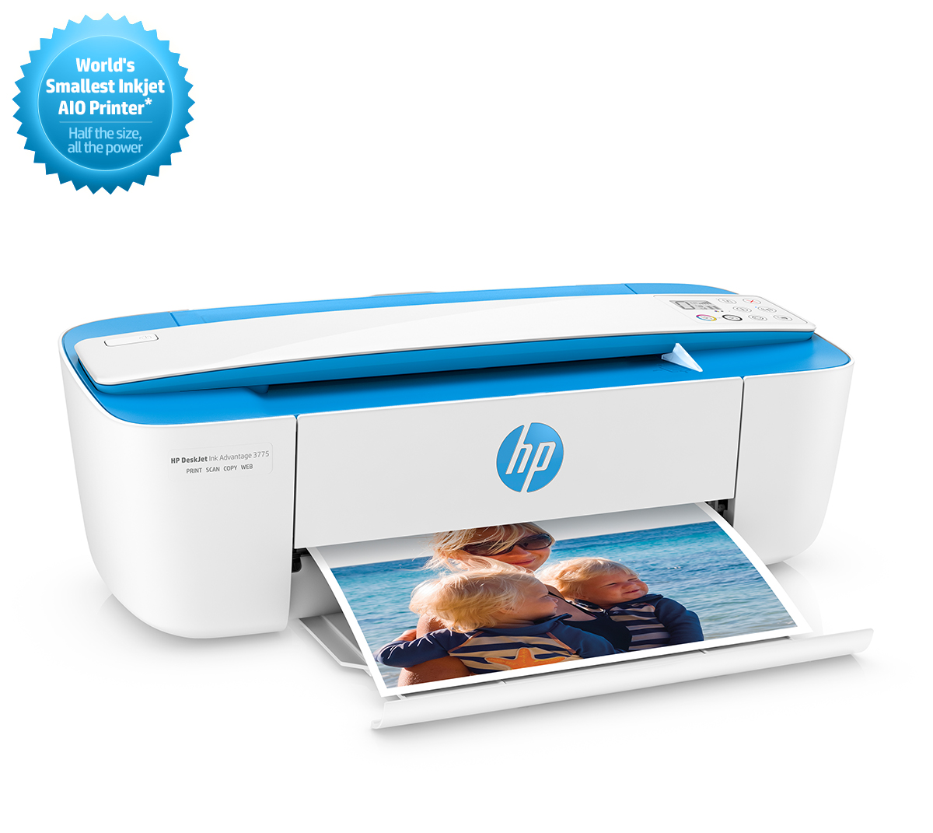
Computer Output Devices
7.2.1 Latest Printer Model :
hp deskjet 3775
Inkjet
4800*1200 DPI
Paper size-A4
Weight 2.33 kg
USB,,Wifi
15/9/2019
Computer Hardware
UHD
Page 21

Slide 22
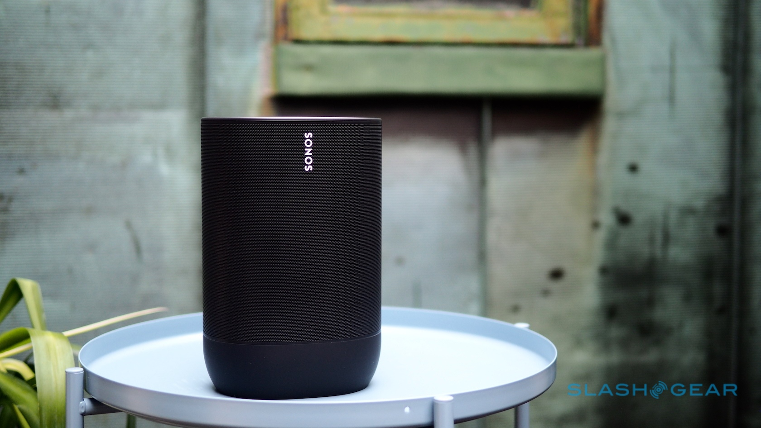
Computer Output Devices
7.3.1 Latest Computer Speakers :
Sonos Bluetooth speaker
Weight 3 kg
USB-C charging port
Wifi-Bluetooth
Battery life: 10 hours
LED Light
15/9/2019
Computer Hardware
UHD
Page 22

Slide 23
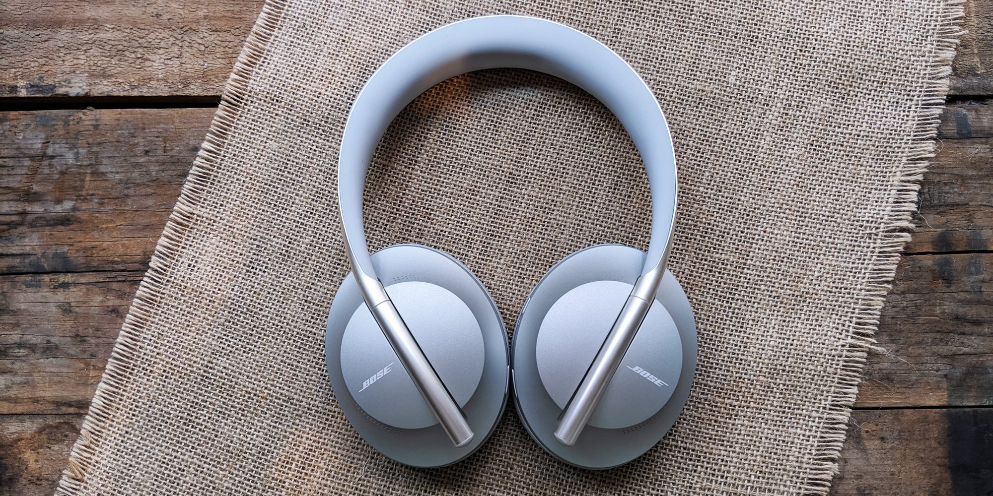
Computer Output Devices
7.4.1 Latest Headphone Models:
bose headphones 700
Battery life: 20 hours
Weight 0.25 kg
2 devices
Bluetooth range 10 meters
USB-C charging port
15/9/2019
Computer Hardware
UHD
Page 23

Slide 24
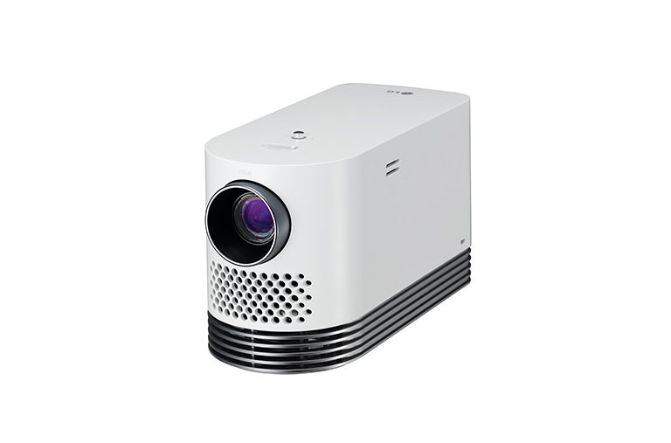
Computer Output Devices
7.5.1 Latest Projector Model :
Full HD (1920*1080)
2,000 lumen
Wireless connection
20,000 hour lamp life
Lamp type - laser
HDMI,USB,….
LG hf80js projector
15/9/2019
Computer Hardware
UHD
Page 24

Slide 25
Summary
In this Presentation we have talked about all the types of Latest Computer hardware including all input and output devices printers and other peripherals.
15/9/2019
Computer Hardware
UHD
Page 25

Slide 26
References
https://computer.howstuffworks.com/what-is-computer-hardware2.htm
https://www.sciencealert.com/this-new-kind-of-universal-computer-memory-could-be-the-low-energy-tech-we-need
https://searchstorage.techtarget.com/definition/SSD-solid-state-drive
https://www.computerweekly.com/feature/MLC-vs-SLC-Which-flash-SSD-is-right-for-you
https://smartiops.com/worlds-fastest-ssds/
https://www.lifewire.com/types-of-ram-4150713
https://www.atpinc.com/blog/computer-memory-types-dram-ram-module
https://www.computerhope.com/jargon/c/cpu.htm
https://www.tutorialspoint.com/computer_fundamentals/computer_input_devices.htm
https://turbofuture.com/computers/Computer-Basics-10-Examples-of-Output-Devices
15/9/2019
Computer Hardware
UHD
Page 26

Slide 27


